Slide 1
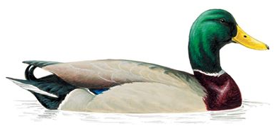
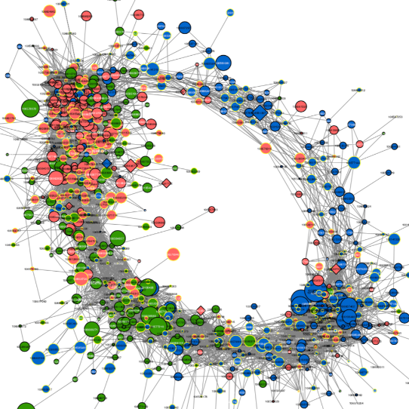
Path analysis
Notes:
Will show two approaches

Slide 2


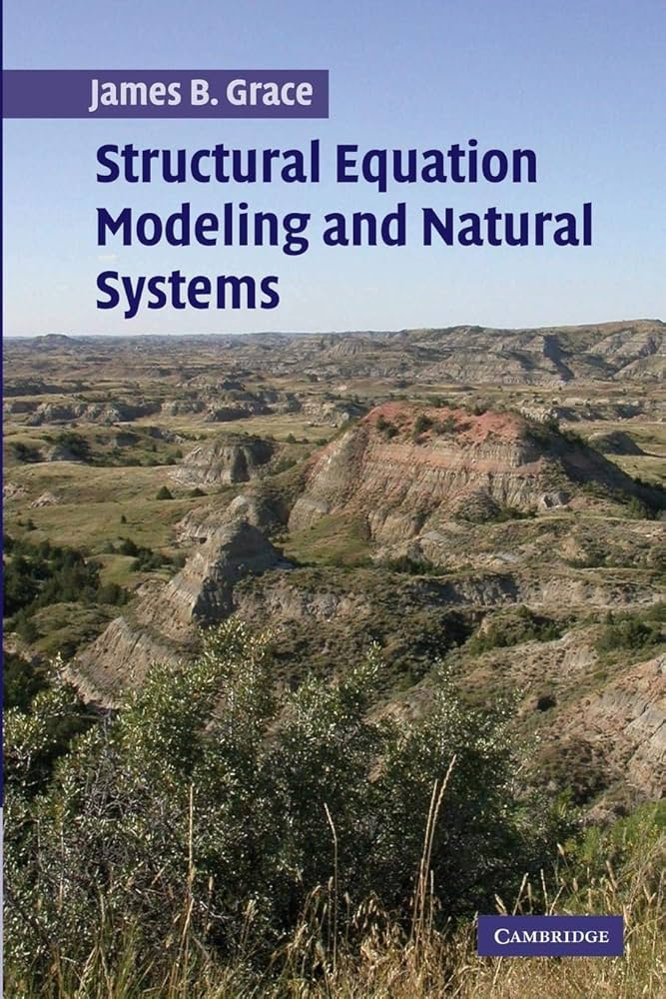


Some fun reading!
Sarah Cubaynes
Jon Lefcheck
James Grace
https://jslefche.github.io/sem_book/
Grace (2006) Cambridge University Press
Cubaynes et al. (2014) Journal of Animal Ecology
Kate Layton-Matthews
Layton-Matthews et al. (2019) Journal of Animal Ecology

Slide 3
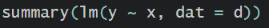
Simulating data (n = 100)
x ~ normal(0,1)
y ~ normal(x, 1)
Grace (2006)

Slide 4
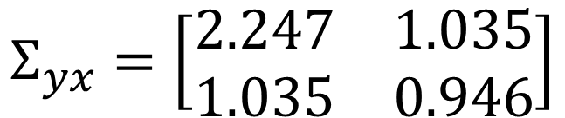
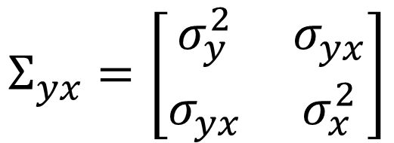
Variance-covariance matrix
$$Σ_{yx}=\left[\begin{matrix}σ_{y}^{2} & σ_{yx} \\ σ_{yx} & σ_{x}^{2}\end{matrix}\right]$$
$$Σ_{yx}=\left[\begin{matrix}2.247 & 1.035 \\ 1.035 & 0.946\end{matrix}\right]$$
Grace (2006)

Slide 5
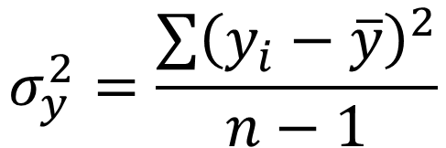
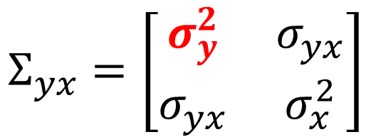
Variance of y
var(x)
$$Σ_{yx}=\left[\begin{matrix}σ_{y}^{2} & σ_{yx} \\ σ_{yx} & σ_{x}^{2}\end{matrix}\right]$$
Variance of y
$$σ_{y}^{2}=\frac{\sum{{\left(y_{i}−\overline{y}\right)}^{2}}}{n−1}$$
Grace (2006), eqs. 3.1 & 3.2

Slide 6
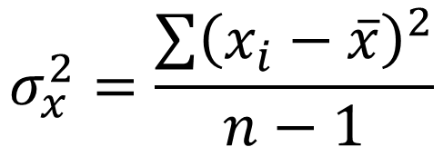
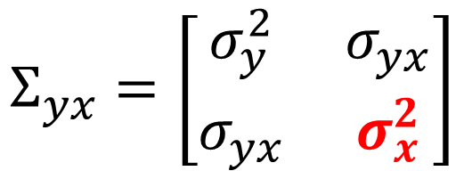
Variance of x
var(x)
$$Σ_{yx}=\left[\begin{matrix}σ_{y}^{2} & σ_{yx} \\ σ_{yx} & σ_{x}^{2}\end{matrix}\right]$$
Variance of x
$$σ_{x}^{2}=\frac{\sum{{\left(x_{i}−\overline{x}\right)}^{2}}}{n−1}$$
Grace (2006), eqs. 3.1 & 3.2

Slide 7
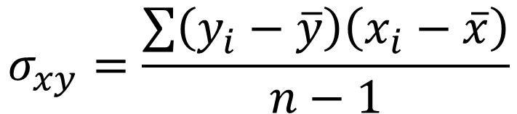
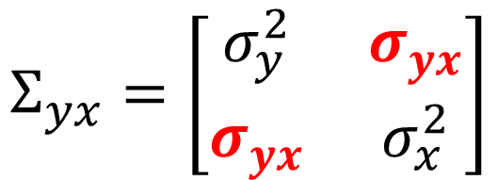
Covariance
cov(x,y)
$$Σ_{yx}=\left[\begin{matrix}σ_{y}^{2} & σ_{yx} \\ σ_{yx} & σ_{x}^{2}\end{matrix}\right]$$
Covariance
$$σ_{xy}=\frac{\sum{\left(y_{i}−\overline{y}\right)\left(x_{i}−\overline{x}\right)}}{n−1}$$

Slide 8
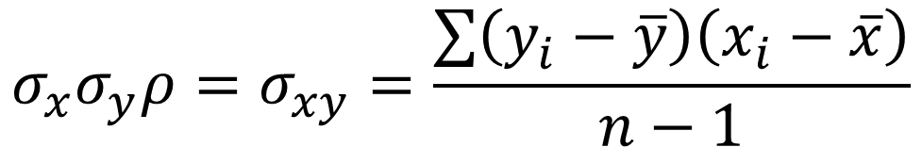
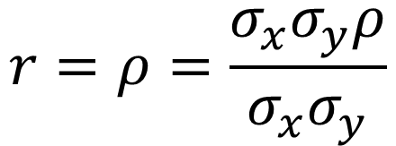
Correlation
cor(x,y)
Covariance
$$σ_{x}σ_{y}ρ=σ_{xy}=\frac{\sum{\left(y_{i}−\overline{y}\right)\left(x_{i}−\overline{x}\right)}}{n−1}$$
Correlation
$$r=ρ=\frac{σ_{x}σ_{y}ρ}{σ_{x}σ_{y}}$$

Slide 9
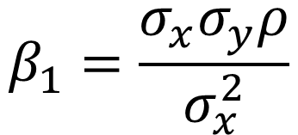
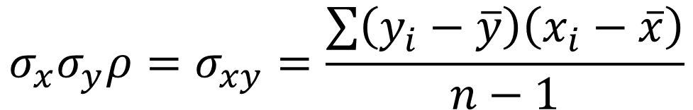
Slope
lm(y ~ x)
Covariance
$$σ_{x}σ_{y}ρ=σ_{xy}=\frac{\sum{\left(y_{i}−\overline{y}\right)\left(x_{i}−\overline{x}\right)}}{n−1}$$
Slope
$$β_{1}=\frac{σ_{x}σ_{y}ρ}{σ_{x}^{2}}$$

Slide 10
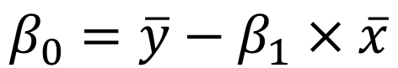
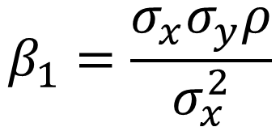
Intercept
lm(y ~ x)
Slope
$$β_{1}=\frac{σ_{x}σ_{y}ρ}{σ_{x}^{2}}$$
Intercept
$$β_{0}=\overline{y}−β_{1}×\overline{x}$$

Slide 11
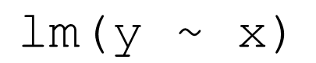
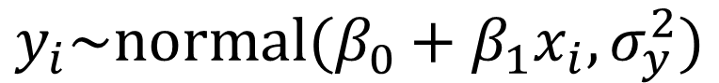
An easy-peasy linear model
R code
$$\text{lm}\text{(}\text{y}\text{ \sim }\text{x}\text{)}$$
Model
$$y_{i}\sim normal(β_{0}+β_{1}x_{i},σ_{y}^{2})$$
Causal diagram
y
x

Slide 12
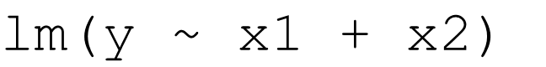
Expanding to two explanatory variables
R code
$$\text{lm}\text{(}\text{y}\text{ \sim }\text{x}\text{1 + }\text{x}\text{2)}$$
Model
$$y_{i}\sim normal(β_{0}+β_{1}x_{1i}+β_{2}x_{2i},σ_{y}^{2})$$
Graph
x₁
y
x₂

Slide 13
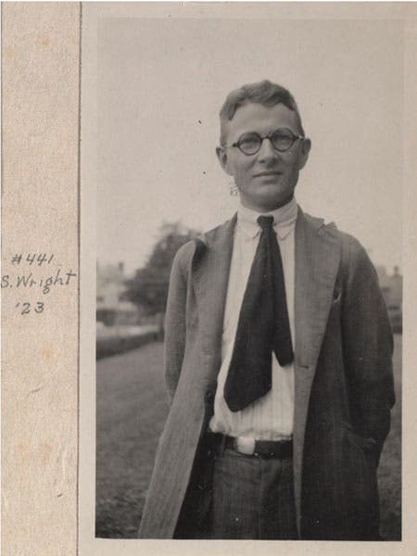
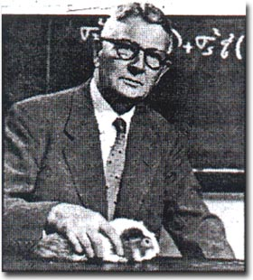
Sewall Wright’s genius breakthrough
Multiple regression
Path analysis
x₁
x₁
y
x₂
y₂
y₁
Wright (1921; 1934)

Slide 14
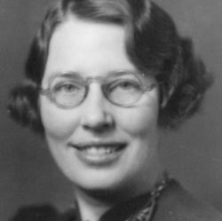
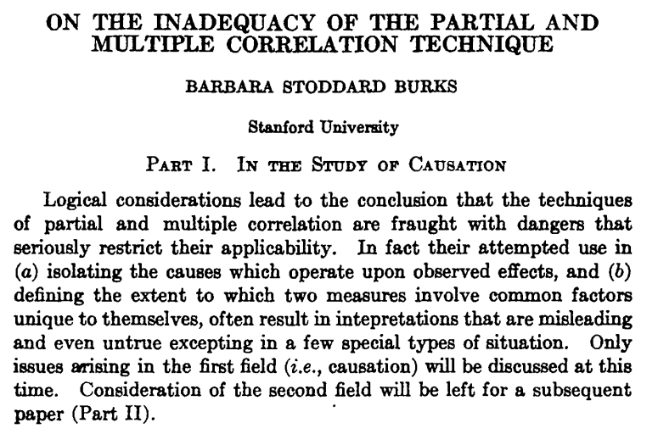
Barbara Burks: nature vs. nurture
Burks (1926)

Slide 15
Barbara Burks: collider bias
Other unmeasured causes
Social status
Parental intelligence
Child’s intelligence
Burks (1926); Pearl (2001) Figure 9.2

Slide 16
Simulating data (n = 100)
x ~ normal(0,1)
y ~ normal(x, 1)
z ~ normal(x + z, 1)
x
Exogenous
y
Endogenous
z
Endogenous

Slide 17
Simulating data (n = 100)
x ~ normal(0,1)
y ~ normal(x, 1)
z ~ normal(x + z, 1)
Exogenous
x
z
Endogenous
y
Mediator
Endogenous

Slide 18
Simulating data (n = 100)
x ~ normal(0,1)
y ~ normal(x, 1)
z ~ normal(x + z, 1)
Exogenous
x
z
Endogenous
y
Mediator
Endogenous

Slide 19
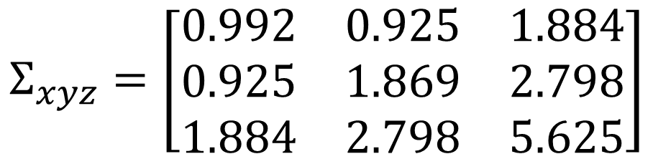
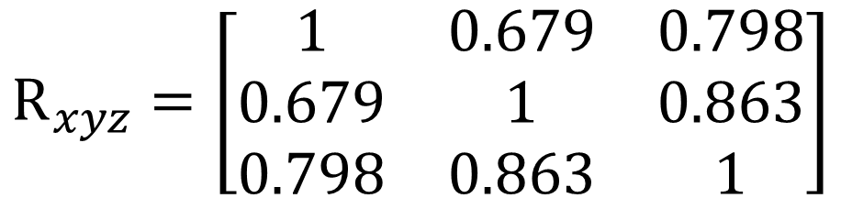
Variance-covariance and correlation matrices
Variance-covariance matrix
$$Σ_{xyz}=\left[\begin{matrix}0.992 & 0.925 & 1.884 \\ 0.925 & 1.869 & 2.798 \\ 1.884 & 2.798 & 5.625\end{matrix}\right]$$
Correlation matrix
$$R_{xyz}=\left[\begin{matrix}1 & 0.679 & 0.798 \\ 0.679 & 1 & 0.863 \\ 0.798 & 0.863 & 1\end{matrix}\right]$$

Slide 20
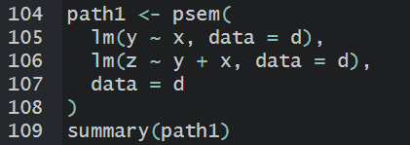
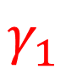
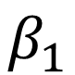
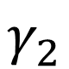
Let’s fit a model
Variance-covariance matrix
$$Σ_{xyz}=\left[\begin{matrix}0.992 & 0.925 & 1.884 \\ 0.925 & 1.869 & 2.798 \\ 1.884 & 2.798 & 5.625\end{matrix}\right]$$
x
Correlation matrix
$$γ_{2}$$
$$R_{xyz}=\left[\begin{matrix}1 & 0.679 & 0.798 \\ 0.679 & 1 & 0.863 \\ 0.798 & 0.863 & 1\end{matrix}\right]$$
z
$$γ_{1}$$
$$β_{1}$$
y

Slide 21
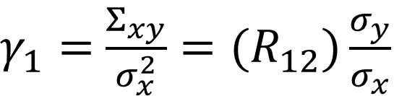
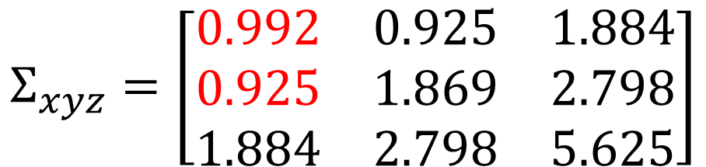
The relationship between y ~ x
Variance-covariance matrix
$γ_{1}=$ $\frac{Σ_{xy}}{σ_{x}^{2}}={(R}_{12})\frac{σ_{y}}{σ_{x}}$
$$Σ_{xyz}=\left[\begin{matrix}0.992 & 0.925 & 1.884 \\ 0.925 & 1.869 & 2.798 \\ 1.884 & 2.798 & 5.625\end{matrix}\right]$$
x
Correlation matrix
$$γ_{2}$$
$$R_{xyz}=\left[\begin{matrix}1 & 0.679 & 0.798 \\ 0.679 & 1 & 0.863 \\ 0.798 & 0.863 & 1\end{matrix}\right]$$
z
$$γ_{1}$$
$$β_{1}$$
y

Slide 22
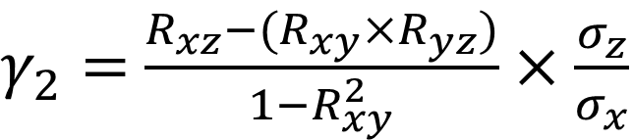
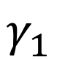
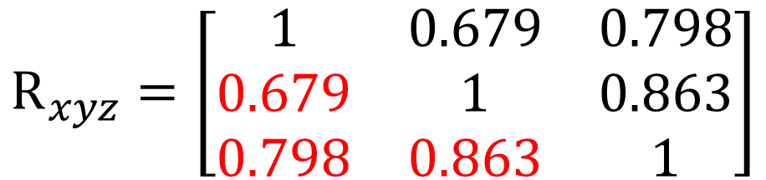
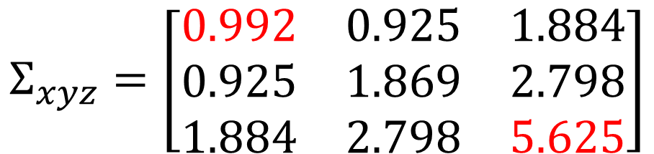
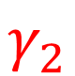
The relationship between z ~ x|y
Variance-covariance matrix
$γ_{2}=$ $\frac{R_{xz}−(R_{xy}×R_{yz})}{1−R_{xy}^{2}}×\frac{σ_{z}}{σ_{x}}$
$$Σ_{xyz}=\left[\begin{matrix}0.992 & 0.925 & 1.884 \\ 0.925 & 1.869 & 2.798 \\ 1.884 & 2.798 & 5.625\end{matrix}\right]$$
x
Correlation matrix
$$γ_{2}$$
$$R_{xyz}=\left[\begin{matrix}1 & 0.679 & 0.798 \\ 0.679 & 1 & 0.863 \\ 0.798 & 0.863 & 1\end{matrix}\right]$$
z
$$γ_{1}$$
$$β_{1}$$
y

Slide 23
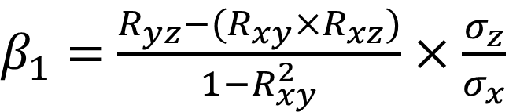
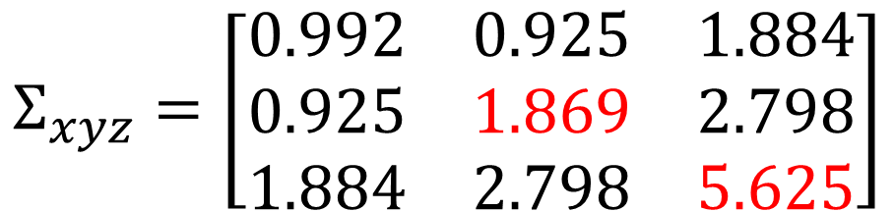
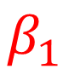
The relationship between z ~ y|x
Variance-covariance matrix
$β_{1}=$ $\frac{R_{yz}−(R_{xy}×R_{xz})}{1−R_{xy}^{2}}×\frac{σ_{z}}{σ_{x}}$
$$Σ_{xyz}=\left[\begin{matrix}0.992 & 0.925 & 1.884 \\ 0.925 & 1.869 & 2.798 \\ 1.884 & 2.798 & 5.625\end{matrix}\right]$$
x
Correlation matrix
$$γ_{2}$$
$$R_{xyz}=\left[\begin{matrix}1 & 0.679 & 0.798 \\ 0.679 & 1 & 0.863 \\ 0.798 & 0.863 & 1\end{matrix}\right]$$
z
$$γ_{1}$$
$$β_{1}$$
y

Slide 24
This was 100 years ago…
They just figured it out… by hand.

Slide 25
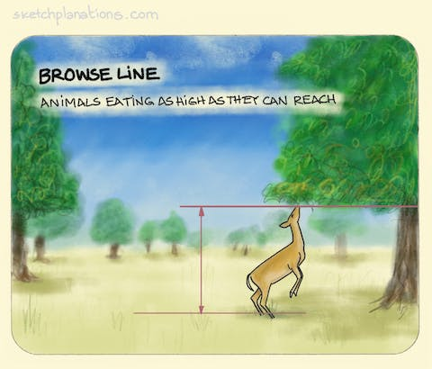
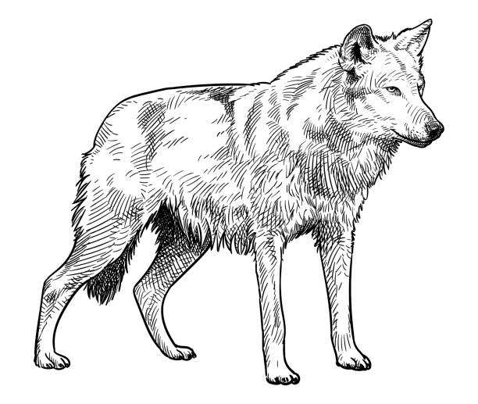
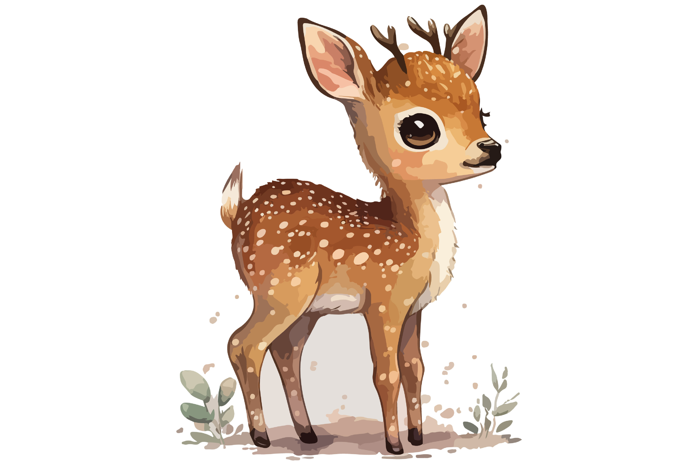
One variable can influence another through a third!
We have always ‘known’ that when we discuss and teach principles of wildlife management and ecology, we can also formally model it.

Slide 26


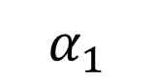
Our first example
Available browse (v; vegetation) as a function of ungulate (u) and predator (w; wolf) abundance.
wolves (w)
$$α_{1}$$
ungulates (u)
$$β_{1}$$
vegetation (v)
Lecture2b_wolf_rsf.R

Slide 27
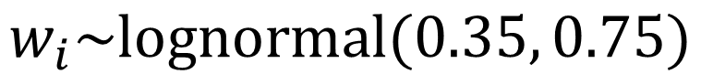
First, we’ll simulate random variation in wolf density (w)
$$w_{i}\sim lognormal(0.35, 0.75)$$

Slide 28
Second, we’ll simulate ungulate density (u) as a function of w
$$u_{i}\sim lognormal(α_{0}+α_{1}w_{i},σ_{v}^{2})$$

Slide 29
Third, we’ll simulate browse density (v) as a function of u
$$v_{i}\sim lognormal(β_{0}+β_{1}u_{i},σ_{v}^{2})$$

Slide 30
We’ll use simple linear models to analyze the data
Identity link functions (i.e., normal distributions) in R
wolves (w)
$$α_{1}$$
ungulates (u)
$$β_{1}$$
vegetation (v)

Slide 31
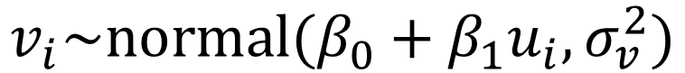
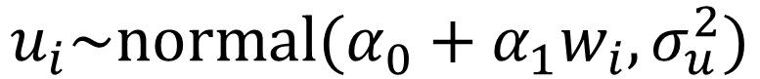
First, we’ll use ‘identity’ link functions in R [lm()]
$$u_{i}\sim normal(α_{0}+α_{1}w_{i},σ_{u}^{2})$$
$$v_{i}\sim normal(β_{0}+β_{1}u_{i},σ_{v}^{2})$$
wolves (w)
$$α_{1}$$
ungulates (u)
$$β_{1}$$
vegetation (v)
It really is this simple

Slide 32

Something to think about
$$u_{i}\sim normal(α_{0}+α_{1}w_{i},σ_{u}^{2})$$
$$v_{i}\sim normal(β_{0}+β_{1}u_{i},σ_{v}^{2})$$
lm(u ~ w)
wolves (w)
$$α_{1}$$
ungulates (u)
It’s easy to calculate the effect of wolves on ungulate (α₁)!

Slide 33
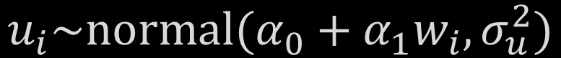
Something to think about
$$u_{i}\sim normal(α_{0}+α_{1}w_{i},σ_{u}^{2})$$
$$v_{i}\sim normal(β_{0}+β_{1}u_{i},σ_{v}^{2})$$
ungulates (u)
$$β_{1}$$
vegetation (v)
lm(v ~ u)
It’s also easy to calculate the effect of ungulates on vegetation (β₁)

Slide 34
Something to think about (we’ll discuss this shortly!)
$$u_{i}\sim normal(α_{0}+α_{1}w_{i},σ_{u}^{2})$$
$$v_{i}\sim normal(β_{0}+β_{1}u_{i},σ_{v}^{2})$$
wolves (w)
$$α_{1}$$
ungulates (u)
$$β_{1}$$
vegetation (v)
How would we calculate the effect of wolves on browse?!

Slide 35
How would we calculate the effect of wolves on browse?!
Talk to your neighbor

Slide 36

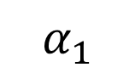
Let’s imagine there is a hypothetical 101st study site with a current density of 2 wolves per ‘unit’
What is the current ML estimate of ungulates and browse?
What would happen to ungulate density if wolves were extirpated?
What would happen to browse if wolves were extirpated?
wolves (w)
$$α_{1}$$
ungulates (u)
$$β_{1}$$
vegetation (v)

Slide 37




Let’s visualize an indirect effect!
$$u_{i}\sim normal(α_{0}+α_{1}w_{i},σ_{u}^{2})$$
$$v_{i}\sim normal(β_{0}+β_{1}u_{i},σ_{v}^{2})$$
We would gain about 8.83 ungulates, going from 29.582 to 38.421.
[0, 38.421]
[2, 29.582]
$$α_{0}=38.4211$$
$$α_{1}=−4.4194$$
What would happen if we went from 2 wolves to 0?

Slide 38
Let’s visualize an indirect effect!
$$u_{i}\sim normal(α_{0}+α_{1}w_{i},σ_{u}^{2})$$
$$v_{i}\sim normal(β_{0}+β_{1}u_{i},σ_{v}^{2})$$
We would gain about 8.83 ungulates, going from 29.582 to 38.421.
[0, 38.421]
[2, 29.582]
$$α_{0}=38.4211$$
$$α_{1}=−4.4194$$
How would that 8.83 gain in ungulates affect browse?

Slide 39




Let’s visualize an indirect effect!
$$u_{i}\sim normal(α_{0}+α_{1}w_{i},σ_{u}^{2})$$
$$v_{i}\sim normal(β_{0}+β_{1}u_{i},σ_{v}^{2})$$
If we gain about 8.83 ungulates, we lose ‘browse’.
$$β_{0}=0.2809$$
$$β_{1}=−0.00738$$
[29.582, 0.0625]
[38.421, -0.002]

Slide 40
Let’s visualize an indirect effect!
$$u_{i}\sim normal(α_{0}+α_{1}w_{i},σ_{u}^{2})$$
$$v_{i}\sim normal(β_{0}+β_{1}u_{i},σ_{v}^{2})$$
[0, 38.421]
[2, 29.582]
[29.582, 0.0625]
[38.421, -0.002]
Losing wolves -> more deer; more deer -> less browse

Slide 41


Let’s visualize an indirect effect!
$$u_{i}\sim normal(α_{0}+α_{1}w_{i},σ_{u}^{2})$$
$$v_{i}\sim normal(β_{0}+β_{1}u_{i},σ_{v}^{2})$$
[0, 38.421]
$$β_{1}=−0.00738$$
[2, 29.582]
$$α_{1}=−4.4194$$
[29.582, 0.0625]
[38.421, -0.002]
$$−0.06524=−0.002 − 0.0625$$
Change in browse

Slide 42
Let’s visualize an indirect effect!
$$u_{i}\sim normal(α_{0}+α_{1}w_{i},σ_{u}^{2})$$
$$v_{i}\sim normal(β_{0}+β_{1}u_{i},σ_{v}^{2})$$
[0, 38.421]
$$β_{1}=−0.00738$$
[2, 29.582]
$$α_{1}=−4.4194$$
[29.582, 0.0625]
[38.421, -0.002]
$$−0.06524=−0.002 − 0.0625=α_{1}\left(β_{1}\right)\left(−2\right)$$
Change in browse

Slide 43
Take-home 1: indirect effects aren’t as ‘horrifying’ as they seem
$$u_{i}\sim normal(α_{0}+α_{1}w_{i},σ_{u}^{2})$$
$$v_{i}\sim normal(β_{0}+β_{1}u_{i},σ_{v}^{2})$$
wolves (w)
$$α_{1}$$
ungulates (u)
$$β_{1}$$
vegetation (v)
i.e., if identity link, then effect of wolves on veg = α₁β₁

Slide 44


$$E\left(v_{i}|w_{i}\right)=[β_{0}+β_{1}\left(α_{0}\right)] +{α_{1}β}_{1}w_{i}$$
$$slope= {α_{1}β}_{1}$$
$$intercept=$$
$$what value of veg would be$$
$$given number of deer if$$
$$there were no wolves$$

Slide 45
Take-home 1: this is easy?!
$$u_{i}\sim normal(α_{0}+α_{1}w_{i},σ_{u}^{2})$$
$$v_{i}\sim normal(β_{0}+β_{1}u_{i},σ_{v}^{2})$$
wolves (w)
$$α_{1}$$
ungulates (u)
$$β_{1}$$
vegetation (v)
i.e., we’re more or less ‘stapling’ two linear models together

Slide 46



Our first analysis: wolf resource selection in Bow Valley
Lecture2c_wolf_rsf.R
Hebblewhite (2000)

Slide 47
Collider bias: wolf resource selection in Bow Valley
*The black line is the direct effect of elevation holding deer abundance constant at the mean.
Deer
+
-
Elevation
Wolf

Slide 48
*Deer abundance will not remain constant as elevation changes
The black line is the direct effect of elevation holding deer abundance constant at the mean.
The grey line is the total effect of elevation via formally acknowledging that increases in elevation will reduce deer abundance.
Deer
-
+
-
Elevation
Wolf

Slide 49
Note that a path analysis and simple glm(used ~ elevation) are similar.
The grey line is the total effect of elevation via formally acknowledging that increases in elevation will reduce deer abundance.
The red line is the stand-alone effect of elevation from a model w/o deer
-
Elevation
Wolf

Slide 50
Why is this important?
AIC (deer + elevation) = 892.93
AIC (elevation) = 937.86
-
Elevation
Wolf
Deer
+
-
Elevation
Wolf

Slide 51

Why is this important?
Canopy
-0.2
0.4
Fire
Response
Prescribed burns were associated with an increase in our ecological response variable of interest (β = 0.4; p < 0.01). Canopy cover negatively effected our response variable of interest (-0.2, p < 0.01).
Imagine you’re interested in the impact of a management action

Slide 52
Why is this important?
Canopy
-1
-0.2
0.4
Fire
Response
Prescribed burns had a positive direct effect on our ecological response variable of interest (β = 0.4; p < 0.01). Burns also reduced canopy cover (β = -1; p < 0.01), which negatively effected our response variable of interest (-0.2, p < 0.01) leading to a total increase of 0.6.
The total effect is 50% greater than the direct effect!

Slide 53
Why is this important?
Canopy
-
-
+
Fire
Response
Inference can change substantially via causal hypotheses

Slide 54
When we ‘fix’ independent variables to estimate effects
Canopy
-
-
+
Fire
Response
We ignore the fact that changes in one covariate can affect another

Slide 55


This can lead to absurdity!
X
N
κ
S

Slide 56

It’s more likely that it will lead to smaller yet important changes
SEM
USFWS

Slide 57



We can build substantially more complex models.
The same assumptions inherent to linear models apply, plus…
x₁
y₂
y₁

Slide 58



The importance of causal diagrams
x
$$γ_{2}$$
z
$$γ_{1}$$
$$β_{1}$$
y

Slide 59
Next up, latent variables…

